Slide 1
Java oktatás
Cluster

Slide 2
Mit nyújt?
Performancia
Scalability
Biztonság
High-Availability

Slide 3
Célok
Application Failover
Migration
Load Balancing

Slide 4
Hogyan
Servlets and JSPs
HTTP Session State Replication
Load Balancing
EJBs and RMI Objects
Replication and Failover
Load Balancing
JMS
Distributing JMS
Load Balancing

Slide 5
Load Balancing for Servlets and JSPs
WebLogic Server
HttpClusterServlet
Apache Server (proxy) plug-in

Slide 6
Load Balancing for EJBs and RMI Objects
Load Balancing algoritmusok
Round-Robin
Weight-Based
Random Load
Server Affinity

Slide 7
HTTP Session State Replication
In-memory replication
JDBC-based persistence
Coherence*Web
A szerializálhatóság kötelező!

Slide 8
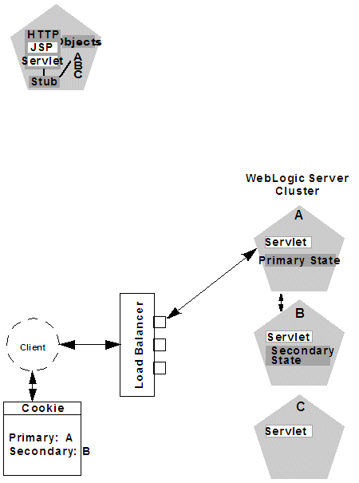
HTTP Session State Replication

Slide 9
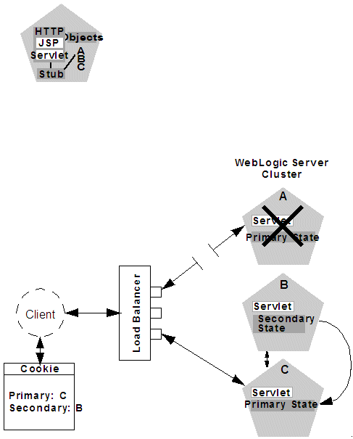
HTTP Session State Replication

Slide 10
Architecture
Szerkezete
Homogén
Heterogén
Rendelkezésre állás
Active-Active
Active-Passive
Rétegek
Combined tier
Single tier

Slide 11
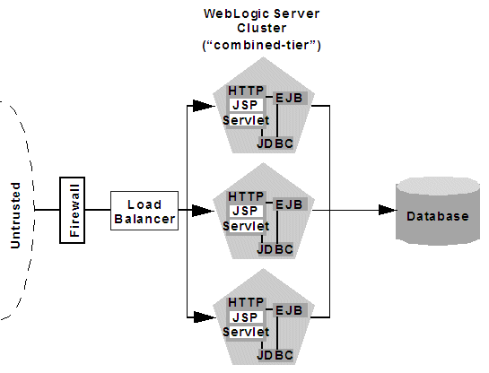
Basic Architecture

Slide 12
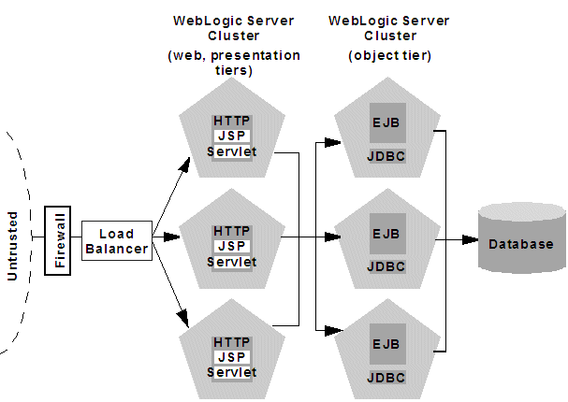
Multi-Tier Architecture

Slide 13
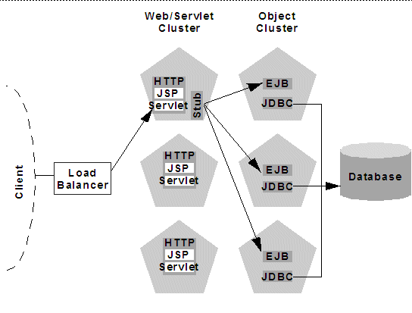
Load Balancing Objects in a Multi-Tier Architecture

